Slide 1
Multi-Threading Programming Session 11 & 12
Course : COMP 6175
Object Oriented Programming
Effective Period : October 2018

Slide 2
Outline
- Introduction - Thread Concept - Creating Tasks and Threads

Slide 3
Introduction
One of the powerful features of Java is its built-in support for multithreading, the concurrent running of multiple tasks within a program. In many programming languages, you have to invoke system-dependent procedures and functions to implement multithreading.

Slide 4
Introduction
Threads exist in several states. The following are those states:
New - When we create an instance of Thread class, a thread is in a new state.
Running - The Java thread is in running state.
Suspended - A running thread can be suspended, which temporarily suspends its activity. A suspended thread can then be resumed, allowing it to pick up where it left off.
Blocked - A java thread can be blocked when waiting for a resource.
Terminated - A thread can be terminated, which halts its execution immediately at any given time. Once a thread is terminated, it cannot be resumed.

Slide 5
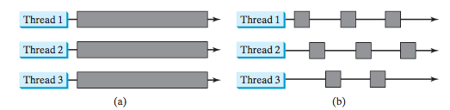
Thread Concept
A thread provides the mechanism for running a task.
With Java, you can launch multiple threads from a program concurrently. These threads can be executed simultaneously in multi- processor systems.
Here multiple threads are running on multiple CPUs.
Here multiple threads share a single CPU.

Slide 6
Thread Concept
In single-processor systems, the multiple threads share CPU time, known as time sharing, and the operating system is responsible for scheduling and allocating resources to them. This arrangement is practical because most of the time the CPU is idle. It does nothing, for example, while waiting for the user to enter data.

Slide 7
Thread Concept
Multithreading can make your program more responsive and interactive, as well as enhance performance.
For example, a good word processor lets you print or save a file while you are typing. In some cases, multithreaded programs run faster than single-threaded programs even on single-processor systems. Java provides exceptionally good support for creating and running threads and for locking resources to prevent conflicts.

Slide 8
Thread Concept
You can create additional threads to run concurrent tasks in the program. In Java, each task is an instance of the Runnable interface, also called a runnable object. A thread is essentially an object that facilitates the execution of a task.

Slide 9
Creating Tasks and Threads
To create tasks, you have to first define a class for tasks, which implements the Runnable interface.
To implement Runnable interface, a class need only implement a single method called run( ), which is declared like this:
public void run( )
Inside run( ), we will define the code that constitutes the new thread.

Slide 10
Creating Tasks and Threads
public class MyClass implements Runnable {
public void run(){
System.out.println("MyClass running");
}
}
To execute the run() method by a thread, pass an instance of MyClass to a Thread in its constructor (A constructor in Java is a block of code similar to a method that's called when an instance of an object is created).
Thread t1 = new Thread(new MyClass ());
t1.start();

Slide 11
Creating Tasks and Threads
Thread t1 = new Thread(new MyClass ());
t1.start();
When the thread is started it will call the run() method of the MyClass instance instead of executing its own run() method. The above example would print out the text "MyClass running ".

Slide 12
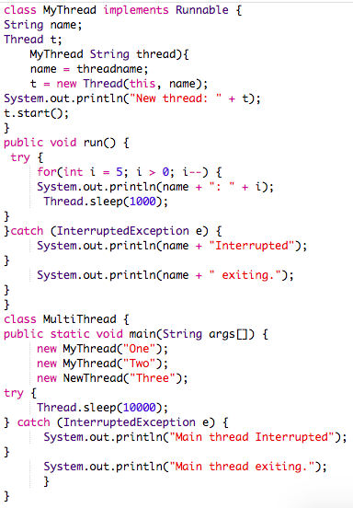
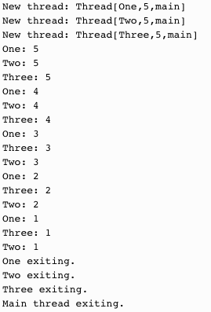
Creating Multiple Threads
The output:

Slide 13
References
Daniel Liang, Y., 2015, Introduction to java programming, vol.10, Pearson Education, New Jersey.
Thread:
https://dzone.com/articles/java-thread-tutorial-creating-threads-and-multithr

